Slide 1
Probability & Distribution

Slide 2
What is Probability
noun
the quality or state of being probable; the extent to which something is likely to happen or be the case.
"the rain will make the probability of a postponement even greater"
Similar:
likelihood
likeliness
prospect
expectation
chance
chances
odds
possibility
a probable or the most probable event.
plural noun: probabilities
"for a time revolution was a strong probability"
Similar:
probable event
prospect
possibility
good/fair/reasonable bet
MATHEMATICS
the extent to which an event is likely to occur, measured by the ratio of the favourable cases to the whole number of cases possible.
"the area under the curve represents probability"

Slide 3
What is Probability (Few things before we dive)
Population:
In statistics, a population is a set of similar items or events which is of interest for some question or experiment
Population may be a group of people suffering from a particular disease, collection of books, group of students.
Sample:
Any part of population under study is called a sample.
While purchasing food grains, we inspect only a handful of grains and draw conclusions about the quality of the whole lot. In this case handful of grains is a sample and the whole lot is a population.
POPULATION IS THE WHOLE THING THAT IS USED UNDER A STUDY, SAMPLE IS PART OF THAT
Pepsi suggested they want 100 Indian under 15-20 age group for a study, define population and sample

Slide 4
What is Probability (Few things before we dive)
Experiment & Sample Space:
In probability theory, an experiment or trial is any procedure that can be infinitely repeated and has a well-defined set of possible outcomes, known as the sample space. An experiment is said to be random if it has more than one possible outcome, and deterministic if it has only one.
Event:
In probability theory, an event is a set of outcomes of an experiment (a subset of the sample space) to which a probability is assigned..
India lost the coin toss against England, Virat called for tails but it was heads : What is the Experient/Sample Space/Event

Slide 5
What is Probability (Few things before we dive)
Independent Event:
One event is not affected by any other events.
Example: You toss a coin three times and it comes up "Heads" each time ... what is the chance that the next toss will also be a "Head"?
The chance is simply 1/2, or 50%, just like ANY OTHER toss
of the coin.
What it did in the past will not affect the current toss!
Dependent Event:
Also called "Conditional", where one event is affected by other events.
Example : If rain comes then play stops
What event is this?
What is the chance of playing football in Mumbai if it rains in in Bangalore?
What is the chance of playing RCB winning IPL if Virat doesn’t play?

Slide 6
What is Probability (Few things before we dive)
Mutually Exclusive Event:
If there is no common sample point between two events, then the events are mutually exclusive ( i.e. the events do not occur together.)
Example: Coin toss, it is either heads or tails
Sure or Certain event:
An event containing all the sample points of the sample space is a sure or certain events.
Impossible event:
An event containing no sample point is called an impossible event.
Can we say independent event = Mutually exclusive event?

Slide 7

What is Probability
Probability - How likely something is to happen or Not happen.
You have used probability before, knowing & unknowingly, the moment you said the word ‘Chance’

Slide 8
What is Probability (Few Maths)
Given a standard die , determine the probability for the following events when rolling the die one time.
i)P(5)
ii) P(even number)
iii) P(7)

Slide 9
What is Probability (Few Maths)
Sample space: {1, 2, 3, 4, 5, 6}
Number of sample points: 6
i) P(5) = # of ways outcome occurs / Total possible outcomes
= 1 / 6
ii) P(even number) = 3 / 6
(Since there are 3 even numbers in the sample space)
iii) P(7) = 0
(This is an impossible event because the die does not contain number 7. Whenever the probability is impossible, the answer is zero)

Slide 10
What is Probability (Few Maths)
There are 4 blue marbles, 5 red marbles, 1 green marble and 2 black marbles in a bag. Suppose you select 1 marble at random. Find each of the following probability.
P( black )
P( blue )
P( blue or black)
P( not green)
P( not purple)

Slide 11
What is Probability
Mathematically, the probability that an event will occur is expressed as a number between 0 and 1.
The probability of event A is represented by P(A).
If P(A) equals zero, event A will almost definitely not occur.
If P(A) is close to zero, there is only a small chance that event A will occur.
If P(A) equals 0.5, there is a 50-50 chance that event A will occur.
If P(A) is close to one, there is a strong chance that event A will occur.
If P(A) equals one, event A will almost definitely occur.

Slide 12
What is Probability
In a statistical experiment, the sum of probabilities for all possible outcomes is equal to one. This means, for example, that if an experiment can have three possible outcomes (A, B, and C), then P(A) + P(B) + P(C) = 1.
Probability that the experiment results in a successful outcome (S) is:
P(S) = ( Number of successful outcomes ) / ( Total number of equally likely outcomes ) = r / n

Slide 13
What is Probability (Conditional Probability)
In many situations, once more information becomes available, we are able to revise our estimates for the probability of further outcomes or events happening.
For example, suppose you go out for lunch at the same place and time every Friday and you are served lunch within 15 minutes with probability 0.9.
However, given that you notice that the restaurant is exceptionally busy, the probability of being served lunch within 15 minutes may reduce to 0.7.
This is the conditional probability of being served lunch within 15 minutes given that the restaurant is exceptionally busy.

Slide 14
What is Probability (Conditional Probability)
The usual notation for "event A occurs given that event B has occurred" is "A | B" (A given B).
The symbol | is a vertical line and does not imply division.
P(A | B) denotes the probability that event A will occur given that event B has occurred already.
A rule that can be used to determine a conditional probability from unconditional probabilities is:
P(A | B) = P(A n B) / P(B)
where:
P(A | B) = the (conditional) probability that event A will occur given that event B has occurred already
P(A n B) = the (unconditional) probability that event A and event B both occur
P(B) = the (unconditional) probability that event B occurs

Slide 15
What is Probability (Conditional Probability)
Example 1:
A math teacher gave her class two tests. 25% of the class passed both tests and 42% of the class passed the first test. What percent of those who passed the first test also passed the second test?
Analysis:
P(second/First) =P(1st and 2nd)/p(1st) = 0.25/0.42
This problem describes a conditional probability since it asks us to find the probability that the second test was passed given that the first test was passed. In the last lesson, the notation for conditional probability was used in the statement of Multiplication Rule 2.

Slide 16
Section divider over two lines or three lines
What is a Probability Distribution
&
How to Spot them

Slide 17
What is a Probability Distribution & How to Spot them
A probability distribution is a function that describes the likelihood of obtaining the possible values that a random variable can assume. In other words, the values of the variable vary based on the underlying probability distribution.
Suppose you draw a random sample and measure the heights of the subjects. As you measure heights, you can create a distribution of heights. This type of distribution is useful when you need to know which outcomes are most likely, the spread of potential values, and the likelihood of different results.

Slide 18
What is a Probability Distribution & How to Spot them
Discrete Data type : The things you can count (i.e Number of heads in coin toss)
Continuous Data type : The thing you can measure (i.e Your height)
What is what?
Number of Wins of KKR in IPL
Number of Pages in Book
Length of your room
Your mobile number

Slide 19
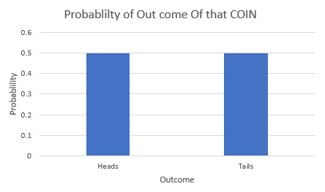
What is a Probability Distribution & How to Spot them
Two type of data = two type of distribution
This an very small data with 6 outcomes from SAME coin. How can we find the distribution of the COIN.
We see we have 3 Heads and 3 Tails. So probability of getting heads is 0.5, same with tails.
If we plot the Probabilities, it will look like this, which is nothing but a Discrete probability distribution, where Total outcome (n) is 2 and Probability of heads(p) is 0.5 over 6 sampling
Outcome
H
T
H
T
H
T

Slide 20
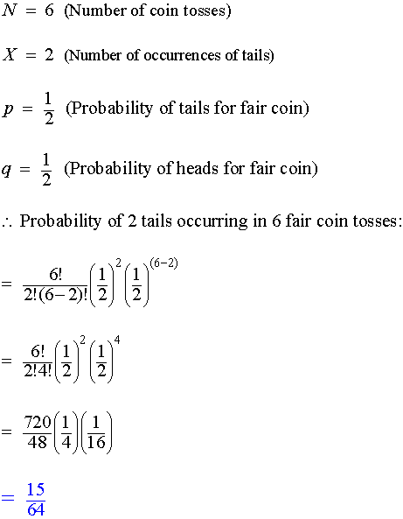
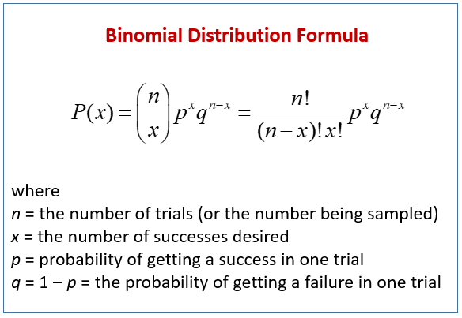
What is a Probability Distribution & How to Spot them
Discrete probability functions are also known as probability mass functions and can assume a discrete number of values. For example, coin tosses and counts of events are discrete functions. These are discrete distributions because there are no in-between values. For example, you can have only heads or tails in a coin toss. Similarly, if you’re counting the number of books that a library checks out per hour, you can count 21 or 22 books, but nothing in between.

Slide 21
What is a Probability Distribution & How to Spot them
Two type of data = two type of distribution
Continuous probability functions are also known as probability density functions. You know that you have a continuous distribution if the variable can assume an infinite number of values between any two values. Continuous variables are often measurements on a scale, such as height, weight, and temperature.
Unlike discrete probability distributions where each particular value has a non-zero likelihood, specific values in continuous distributions have a zero probability. For example, the likelihood of measuring a temperature that is exactly 32 degrees is zero.
Why? Consider that the temperature can be an infinite number of other temperatures that are infinitesimally higher or lower than 32. Statisticians say that an individual value has an infinitesimally small probability that is equivalent to zero.

Slide 22
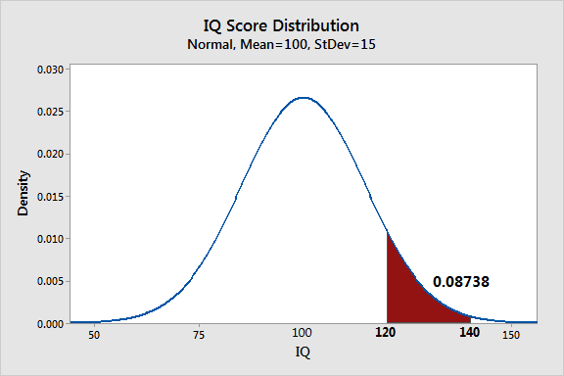
What is a Probability Distribution & How to Spot them
Two type of data = two type of distribution
Let’s start off with the normal distribution to show how to use continuous probability distributions.
The distribution of IQ scores is defined as a normal distribution with a mean of 100 and a standard deviation of 15. We’ll create the probability plot of this distribution. Additionally, let’s determine the likelihood that an IQ score will be between 120-140.
Examine the properties of the probability plot . We can see that it is a symmetric distribution where values occur most frequently around 100, which is the mean. The probabilities drops-off as you move away from the mean in both directions. The shaded area for the range of IQ scores between 120-140 contains 8.738% of the total area under the curve. Therefore, the likelihood that an IQ score falls within this range is 0.08738.

Slide 23
What is a Probability Distribution & How to Spot them
Example of Distribution
Binomial –Discrete – 2 output – multiple coin toss
Multinomial- Discrete- >2 output
Poisson –Count Distribution
There are various others (e.g Negative Binomial,Hypergeometric)
Normal – Cont.(Bell Curve)
Exponential – Cont.(Life curve, recently seen in Covid)
There are various others (e.g Uniform,Gamma,Beta,chisq,F,T etc)
Why the hell do we need this thing?
This is the base of rest of Statistical process / Machine Learning
This is the base of Hypothesis testing/ if you don’t know which distribution your hypothesis test doesn’t make sense
Data cleaning

Slide 24
What is a Probability Distribution & How to Spot them
Additional Resources:
https://statisticsbyjim.com/basics/probability-distributions/
https://www.youtube.com/watch?v=1uW3qMFA9Ho&list=PLUl4u3cNGP60hI9ATjSFgLZpbNJ7myAg6

Slide 25
Section divider over two lines or three lines
Thank You

